Slide 1
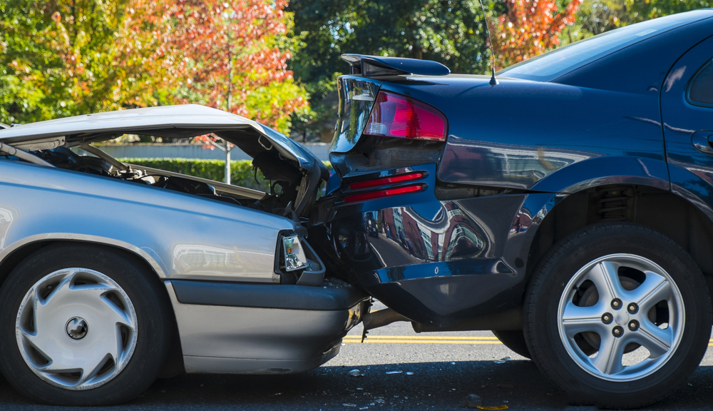
US Accidents Data Analysis
Every 24 seconds someone dies on the road.
Image Source: Link
A Countrywide Traffic Accident Dataset
DAB103-21S-003 (Analytical Tools & Decision Making 21 Spring - 003)
June,29 2021

Slide 2





Our Team
Group 03
Hitarth Mehta
W0776103
Paramjit Singh
W0784180
Kulwinder Singh
W0780590
Janki Kothari
W0779738
Carmen Vivine
W0768108

Slide 3
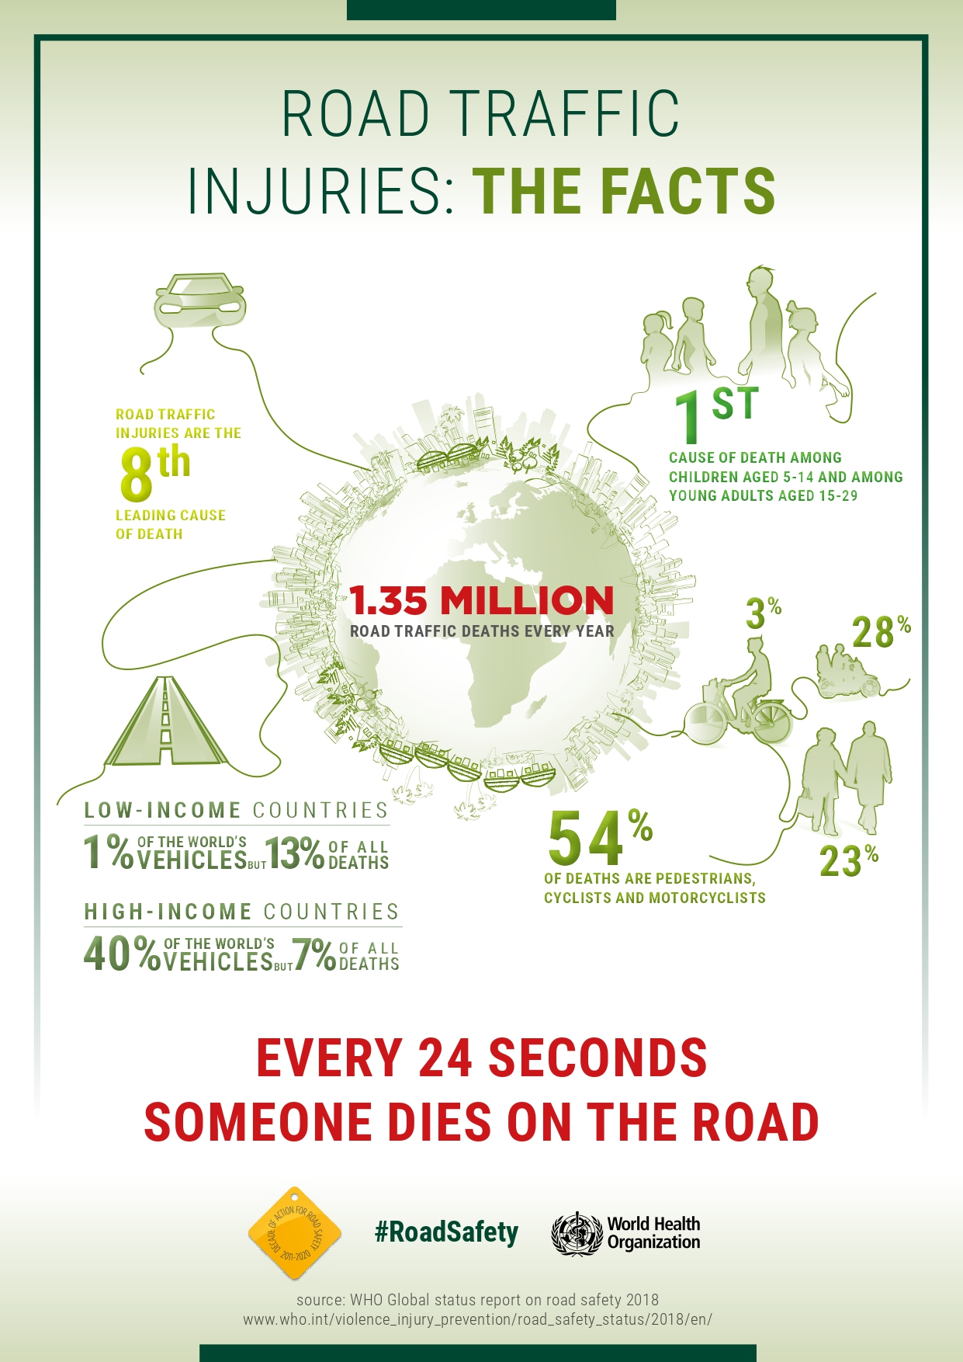
Introduction
US-Accidents : A Countrywide
Traffic Accident Dataset
A Countrywide Traffic Accident Dataset
DAB103-21S-003 (Analytical Tools & Decision Making 21 Spring - 003)
June,29 2021

Slide 4

Dataset Overview
A Countrywide Traffic Accident Dataset (2016 - 2020)
This dataset has been collected in real-time, using multiple Traffic APIs. Currently, it contains accident data that are collected from February 2016 to Dec 2020 for the Contiguous United States.
This is a nationwide car accident dataset that spans 49 states in the United States.
The accident data was acquired using different APIs that give streaming traffic incident (or event) data from February 2016 to December 2020.
This dataset contains approximately 3 million accident records collected by a range of entities including US and state departments of transportation, law enforcement agencies, traffic cameras, and traffic sensors within road networks
Link for Kaggle dataset: https://www.kaggle.com/sobhanmoosavi/us-accidents
Image Source: Link
A Countrywide Traffic Accident Dataset
DAB103-21S-003 (Analytical Tools & Decision Making 21 Spring - 003)
June,29 2021

Slide 5
US-Accidents A Countrywide Traffic Accident Dataset (2016 - 2020)
Acknowledgments
A Countrywide Traffic Accident Dataset (2016 - 2020)
Moosavi, Sobhan, Mohammad Hossein Samavatian, Srinivasan Parthasarathy, and Rajiv Ramnath. “A Countrywide Traffic Accident Dataset.”, arXiv preprint arXiv:1906.05409 (2019).
Moosavi, Sobhan, Mohammad Hossein Samavatian, Srinivasan Parthasarathy, Radu Teodorescu, and Rajiv Ramnath. “Accident Risk Prediction based on Heterogeneous Sparse Data: New Dataset and Insights.” In proceedings of the 27th ACM SIGSPATIAL International Conference on Advances in Geographic Information Systems, ACM, 2019.
A Countrywide Traffic Accident Dataset
DAB103-21S-003 (Analytical Tools & Decision Making 21 Spring - 003)
June,29 2021

Slide 6

Features in the Dataset
ID: This is a unique identifier of the accident record.
Severity: Shows the severity of the accident, a number between 1 and 4, where 1 indicates the least impact on traffic (i.e., short delay as a result of the accident) and 4 indicates a significant impact on traffic (i.e., long delay).
Start_Time: Shows start time of the accident in local time zone.
End_Time: Shows end time of the accident in local time zone.
Start_Lat: Shows latitude in GPS coordinate of the start point.
Start_Lng: Shows longitude in GPS coordinate of the start point.
End_Lat: Shows latitude in GPS coordinate of the end point.
End_Lng: Shows longitude in GPS coordinate of the end point.
Distance(mi): The length of the road extent affected by the accident.
Description: Shows natural language description of the accident.
Accident Attributes
A Countrywide Traffic Accident Dataset
DAB103-21S-003 (Analytical Tools & Decision Making 21 Spring - 003)
June,29 2021

Slide 7

Features in the Dataset
Number: Shows the street number in address field.
Street: Shows the street name in address field.
Side: Shows the relative side of the street (Right/Left) in address field.
City: Shows the city in address field.
County: Shows the county in address field.
State: Shows the state in address field.
Zipcode: Shows the zipcode in address field.
Country: Shows the country in address field.
Timezone: Shows timezone based on the location of the accident (eastern, central, etc.).
Address Attributes
A Countrywide Traffic Accident Dataset
DAB103-21S-003 (Analytical Tools & Decision Making 21 Spring - 003)
June,29 2021

Slide 8

Features in the Dataset
Airport_Code: Denotes an airport-based weather station which is the closest one to location of the accident.
Weather_Timestamp: Shows the time-stamp of weather observation record (in local time).
Temperature(F): Shows the temperature (in Fahrenheit).
Wind_Chill(F): Shows the wind chill (in Fahrenheit).
Humidity(%): Shows the humidity (in percentage).
Pressure(in): Shows the air pressure (in inches).
Visibility(mi): Shows visibility (in miles).
Wind_Direction: Shows wind direction.
Wind_Speed(mph): Shows wind speed (in miles per hour).
Precipitation(in): Shows precipitation amount in inches, if there is any.
Weather_Condition: Shows the weather condition (rain, snow, thunderstorm, fog, etc.).
Weather Attributes
A Countrywide Traffic Accident Dataset
DAB103-21S-003 (Analytical Tools & Decision Making 21 Spring - 003)
June,29 2021

Slide 9

Features in the Dataset
Amenity: A Point-Of-Interest (POI) annotation which indicates presence of amenity in a nearby location.
Bump: A POI annotation which indicates presence of speed bump or hump in a nearby location.
Crossing: A POI annotation which indicates presence of crossing in a nearby location.
Give_Way: A POI annotation which indicates presence of give_way sign in a nearby location.
Junction: A POI annotation which indicates presence of junction in a nearby location.
No_Exit: A POI annotation which indicates presence of no exit sign in a nearby location.
Railway: A POI annotation which indicates presence of railway in a nearby location.
Roundabout: A POI annotation which indicates presence of roundabout in a nearby location.
Station: A POI annotation which indicates presence of station (bus, train, etc.) in a nearby location.
Stop: A POI annotation which indicates presence of stop sign in a nearby location.
Traffic_Calming: A POI annotation which indicates presence of traffic_calming means in a nearby location.
Traffic_Signal: A POI annotation which indicates presence of traffic_signal in a nearby location.
Turning_Loop: A POI annotation which indicates presence of turning_loop in a nearby location.
POI Attributes
A Countrywide Traffic Accident Dataset
DAB103-21S-003 (Analytical Tools & Decision Making 21 Spring - 003)
June,29 2021

Slide 10

Features in the Dataset
Sunrise_Sunset: Shows the period of day (i.e. day or night) based on sunrise/sunset.
Civil_Twilight: Shows the period of day (i.e. day or night) based on civil twilight.
Nautical_Twilight: Shows the period of day (i.e. day or night) based on nautical twilight.
Astronomical Twilight: Shows the period of day (i.e. day or night) based on astronomical twilight.
Period-of-Day
A Countrywide Traffic Accident Dataset
DAB103-21S-003 (Analytical Tools & Decision Making 21 Spring - 003)
June,29 2021

Slide 11
The Problem
Motivation
Every 24 seconds someone dies on the road.
What we want to prove or disprove
MILLIONS ROAD TRAFFIC DEATHS EVERY YEAR
CAUSE OF DEATH AMONG CHILDREN AGED 5-14 AND AMONG YOUNG ADULTS AGED 15-29
CAUSES OF DEATHS PEDESTRAINS, CYCLISTS AND MOTORCYCLISTS
PEDESTRIAN AND BICYCLIST FATALITIES CONTINUE TO RISE IN THE UNITED STATES. ACCORDING TO THE NATIONAL HIGHWAY TRAFFIC SAFETY ADMINISTRATION (NHTSA), MORE PEDESTRIANS AND CYCLISTS WERE KILLED IN 2018 THAN IN ANY YEAR SINCE 1990
MORE THAN 38,000 PEOPLE DIE EVERY YEAR IN CRASHES ON U.S. ROADWAYS. THE U.S. TRAFFIC FATALITY RATE IS 12.4 DEATHS PER 100,000 INHABITANTS.
ROAD CRASHES ARE THE LEADING CAUSE OF DEATH IN THE U.S. FOR PEOPLE AGED 1-54.
THE U.S. SUFFERS THE MOST ROAD CRASH DEATHS OF ANY HIGH-INCOME COUNTRY, ABOUT 50% HIGHER THAN SIMILAR COUNTRIES IN WESTERN EUROPE, CANADA, AUSTRALIA AND JAPAN.
A number of factors contribute to road crashes and resulting deaths and severity of injuries. These include:
Poor road infrastructure and management
Non-road worthy vehicles
Unenforced or non-existent traffic laws
Unsafe road user behaviors and
Inadequate post-crash care.
By understanding each of these factors and through planning, effective management and evidence-based interventions, road crashes can be predicted and prevented. Having access to accurate and updated information about the current road situation enables drivers, pedestrians and passengers to make informed road safety decisions.
A Countrywide Traffic Accident Dataset
DAB103-21S-003 (Analytical Tools & Decision Making 21 Spring - 003)
June,29 2021

Slide 12


Code Repository
10
1
1
Github link :- https://github.com/disuhitarth/EDA_Projects.git
Dataset Link :- https://www.kaggle.com/sobhanmoosavi/us-accidents
A Countrywide Traffic Accident Dataset
DAB103-21S-003 (Analytical Tools & Decision Making 21 Spring - 003)
June,29 2021

Slide 13
Exploring Raw Dataset
A Countrywide Traffic Accident Dataset
DAB103-21S-003 (Analytical Tools & Decision Making 21 Spring - 003)
June,29 2021

Slide 14
From Initial observation , We can see that, there are 47 columns and 2906610 rows in the dataset
Datatypes: bool(13), float64(13), int64(1), object(20)
Initial Observation:
Columns such as Severity, lat, lng, distance, Weather and traffic related columns are of Numeric type. Rest of the columns are objects and Booleans.
Start_Time and End_Time columns are of object type; It should be in date time format.
A Countrywide Traffic Accident Dataset
DAB103-21S-003 (Analytical Tools & Decision Making 21 Spring - 003)
June,29 2021

Slide 15

EDA Questions
What are the top 10 cities having highest number of accidents.
What are the top 5 states having highest number of accidents.
Show heatmap distribution of accidents zipcodewise on US Map.
Which states having higher accident severity count? Show it on map.
Does Higher population areas such as big cities, have more accident?
Does Higher population areas such as big cities, have more severe accident?
What places have the longer accident duration time? Why?
A Countrywide Traffic Accident Dataset
DAB103-21S-003 (Analytical Tools & Decision Making 21 Spring - 003)
June,29 2021

Slide 16

Summary statistics of Numeric Columns
 | Severity | Start_Lat | Start_Lng | End_Lat | End_Lng | Distance(mi) | Number | Temperature (F) | Wind_Chill (F) | Humidity (%) | Pressure (in) | Visibility (mi) | Wind_Speed (mph) | Precipitation(in)
count | 2.906610e+06 | 2.906610e+06 | 2.906610e+06 | 2.623789e+06 | 2.623789e+06 | 2.906610e+06 | 1.014938e+06 | 2.839386e+06 | 1.722751e+06 | 2.835340e+06 | 2.849702e+06 | 2.834532e+06 | 2.599447e+06 | 1.605284e+06
mean | 2.288649e+00 | 3.653027e+01 | -9.642676e+01 | 3.651733e+01 | -9.620367e+01 | 3.980541e-01 | 6.789728e+03 | 6.098873e+01 | 5.499048e+01 | 6.537758e+01 | 2.965685e+01 | 9.116766e+00 | 7.818111e+00 | 1.119459e-02
std | 5.541618e-01 | 5.013964e+00 | 1.775412e+01 | 5.016609e+00 | 1.765971e+01 | 1.592556e+00 | 1.697225e+04 | 1.845258e+01 | 2.219542e+01 | 2.287854e+01 | 9.094133e-01 | 2.837271e+00 | 5.431171e+00 | 1.540812e-01
min | 1.000000e+00 | 2.455527e+01 | -1.246238e+02 | 2.455527e+01 | -1.246238e+02 | 0.000000e+00 | 0.000000e+00 | -8.900000e+01 | -8.900000e+01 | 1.000000e+00 | 0.000000e+00 | 0.000000e+00 | 0.000000e+00 | 0.000000e+00
25% | 2.000000e+00 | 3.366453e+01 | -1.178232e+02 | 3.364659e+01 | -1.177020e+02 | 0.000000e+00 | 9.650000e+02 | 4.890000e+01 | 3.900000e+01 | 4.900000e+01 | 2.959000e+01 | 1.000000e+01 | 4.600000e+00 | 0.000000e+00
50% | 2.000000e+00 | 3.609977e+01 | -9.116690e+01 | 3.605898e+01 | -9.105163e+01 | 0.000000e+00 | 3.093000e+03 | 6.300000e+01 | 5.800000e+01 | 6.800000e+01 | 2.992000e+01 | 1.000000e+01 | 7.000000e+00 | 0.000000e+00
75% | 3.000000e+00 | 4.037505e+01 | -8.085814e+01 | 4.033133e+01 | -8.084679e+01 | 2.790000e-01 | 7.976000e+03 | 7.500000e+01 | 7.200000e+01 | 8.500000e+01 | 3.007000e+01 | 1.000000e+01 | 1.040000e+01 | 0.000000e+00
max | 4.000000e+00 | 4.900220e+01 | -6.711317e+01 | 4.907500e+01 | -6.710924e+01 | 3.336300e+02 | 9.999997e+06 | 2.030000e+02 | 1.740000e+02 | 1.000000e+02 | 5.804000e+01 | 1.400000e+02 | 9.840000e+02 | 2.400000e+01
A Countrywide Traffic Accident Dataset
DAB103-21S-003 (Analytical Tools & Decision Making 21 Spring - 003)
June,29 2021

Slide 17
Observation:
Looks like the Temperature ranges between -89 and 203 Fahrenheit in the data.
The Average Severity observed in 75% of dataset is around 3 out of 4 which is very high.
Fact : There are multiple Time Zone in US.
To do: Compare accidents dataset with US Population Dataset(Find It on the Internet).
To do: Convert Start_Time and End_Time type from object to datetime.
Questions:
Are the accidents happening more in colder regions or hot regions ?
Does the visibility really leads to the higher severity of accidents ?
Is overall accidents rising by every year?
A Countrywide Traffic Accident Dataset
DAB103-21S-003 (Analytical Tools & Decision Making 21 Spring - 003)
June,29 2021

Slide 18
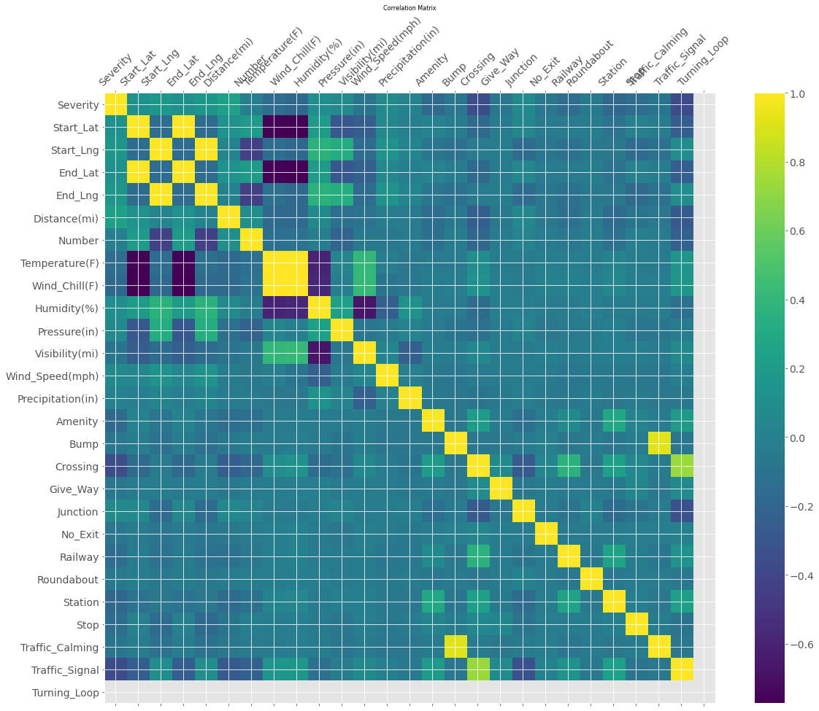
Correlation between numeric columns

Slide 19
Observation:
08
The value of ρ
0.7 to 0.9 positive or negative indicates a strong correlation. 0.5 to 0.7 positive or negative indicates a moderate correlation. 0.3 to 0.5 positive or negative indicates a weak correlation. 0 to 0.3 positive or negative indicates a negligible correlation.
Looks like few columns from the data is having positive linear correlation.
Here Turning loop is having no correlation because whole column is NA.(So we can remove it from the dataset while doing Cleanup)
Questions:
How many accident records having bump in the road nearby?
How many accident records having traffic_Signal on the road nearby?
A Countrywide Traffic Accident Dataset
DAB103-21S-003 (Analytical Tools & Decision Making 21 Spring - 003)
June,29 2021

Slide 20
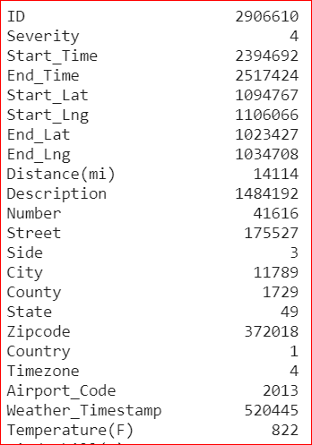
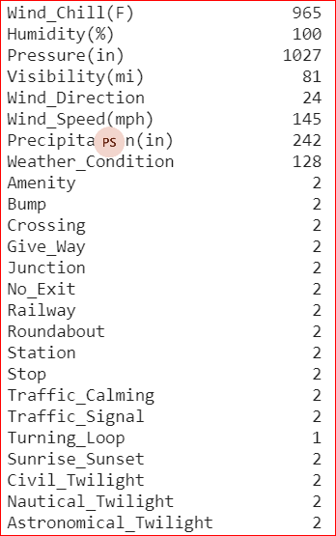
Count of Unique values in Dataset
A Countrywide Traffic Accident Dataset
DAB103-21S-003 (Analytical Tools & Decision Making 21 Spring - 003)
June,29 2021

Slide 21
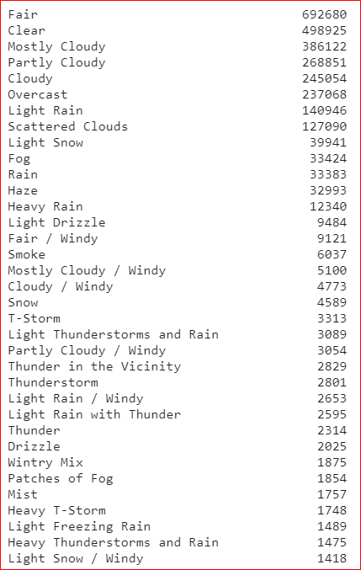
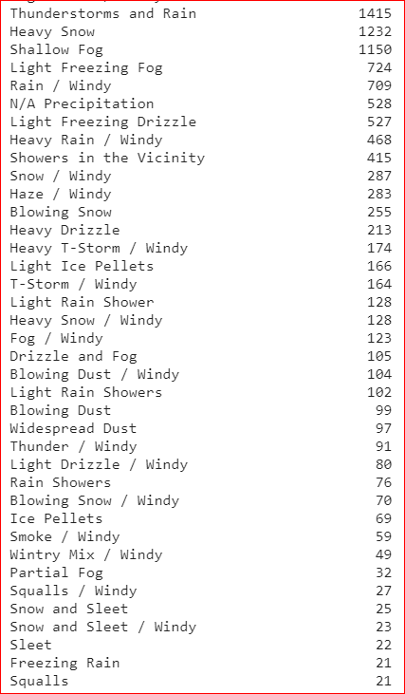
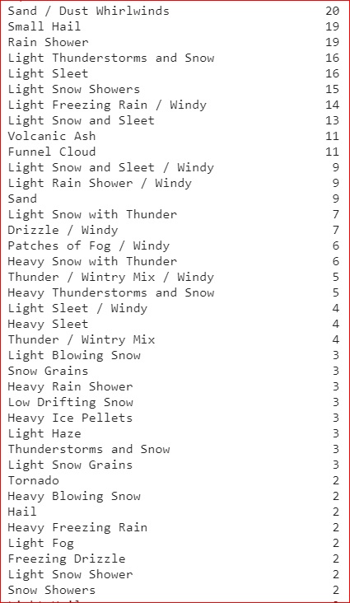
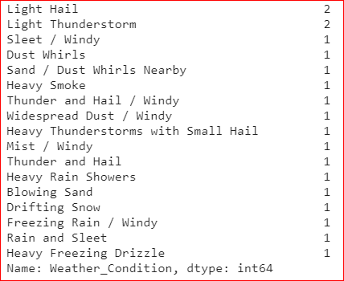
Accidents count in different Weather conditions
A Countrywide Traffic Accident Dataset
DAB103-21S-003 (Analytical Tools & Decision Making 21 Spring - 003)
June,29 2021

Slide 22
Observation:
A little less then half of the Weather conditions have less then 10 accident records in this huge dataset.
If the count these observations are not of severe accidents, then we can drop those records to have a better picture of dataset.
Questions:
Which top 5 five weather conditions is having the higher severity accidents count.
A Countrywide Traffic Accident Dataset
DAB103-21S-003 (Analytical Tools & Decision Making 21 Spring - 003)
June,29 2021

Slide 23
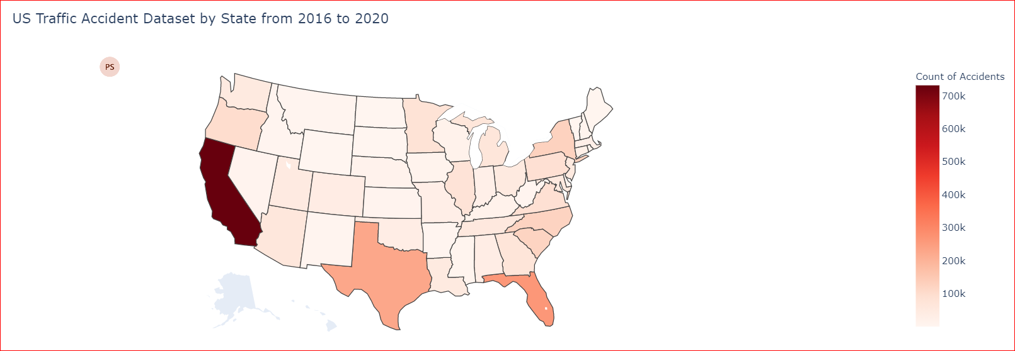
State wise Accidents
A Countrywide Traffic Accident Dataset
DAB103-21S-003 (Analytical Tools & Decision Making 21 Spring - 003)
June,29 2021

Slide 24
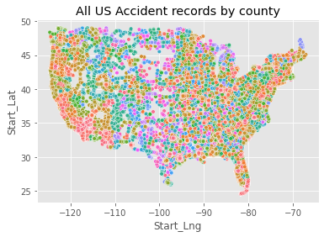
All US Accident records by county
A Countrywide Traffic Accident Dataset
DAB103-21S-003 (Analytical Tools & Decision Making 21 Spring - 003)
June,29 2021

Slide 25
Observation:
Looks like there are too many data points which makes it difficult to understand US accident dataset records.
Solution:
To save Processing time and Memory - reducing dataset into sample of 10000 to understand data clearly.
A Countrywide Traffic Accident Dataset
DAB103-21S-003 (Analytical Tools & Decision Making 21 Spring - 003)
June,29 2021

Slide 26
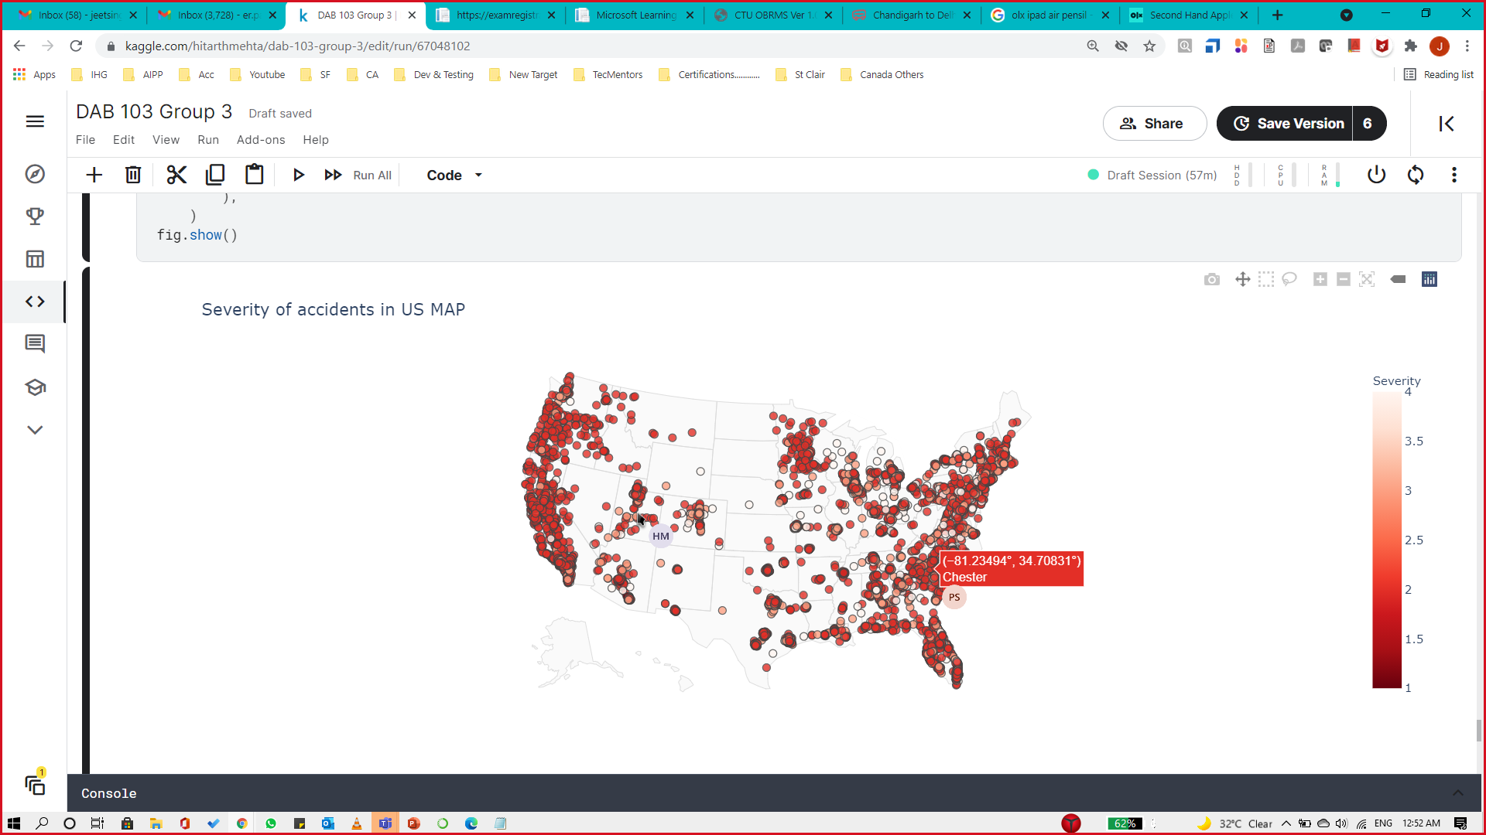
Accidents by Severity on sample dataset (10,000)
A Countrywide Traffic Accident Dataset
DAB103-21S-003 (Analytical Tools & Decision Making 21 Spring - 003)
June,29 2021

Slide 27
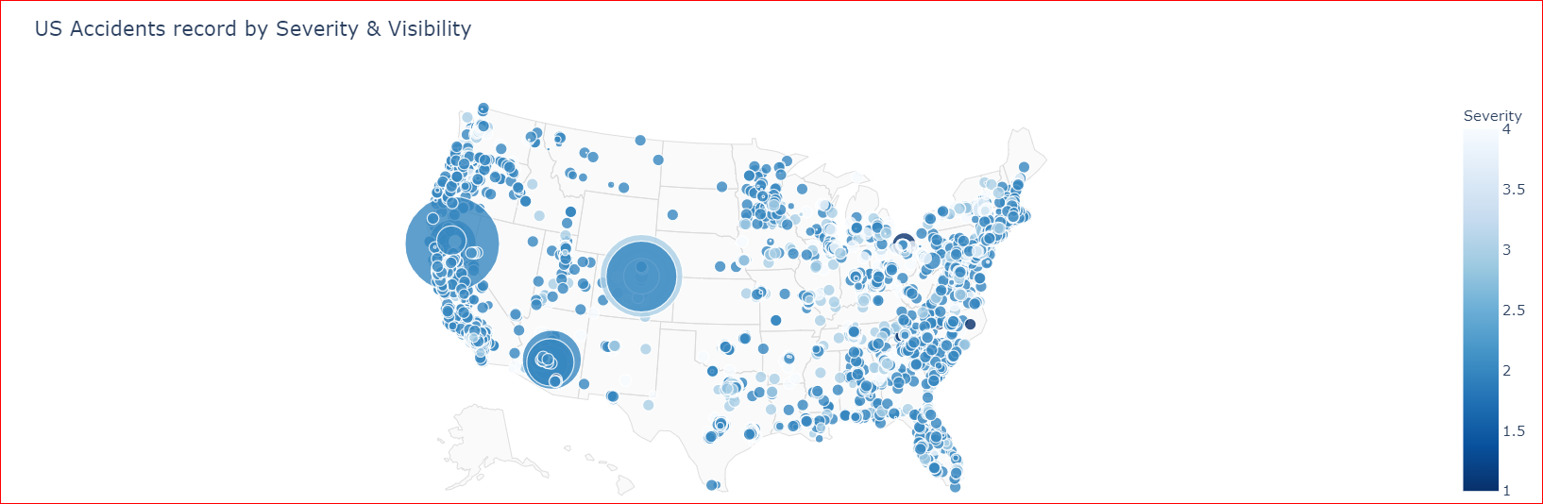
US Accident records by Visibility & Severity on sample dataset (10,000)
A Countrywide Traffic Accident Dataset
DAB103-21S-003 (Analytical Tools & Decision Making 21 Spring - 003)
June,29 2021

Slide 28
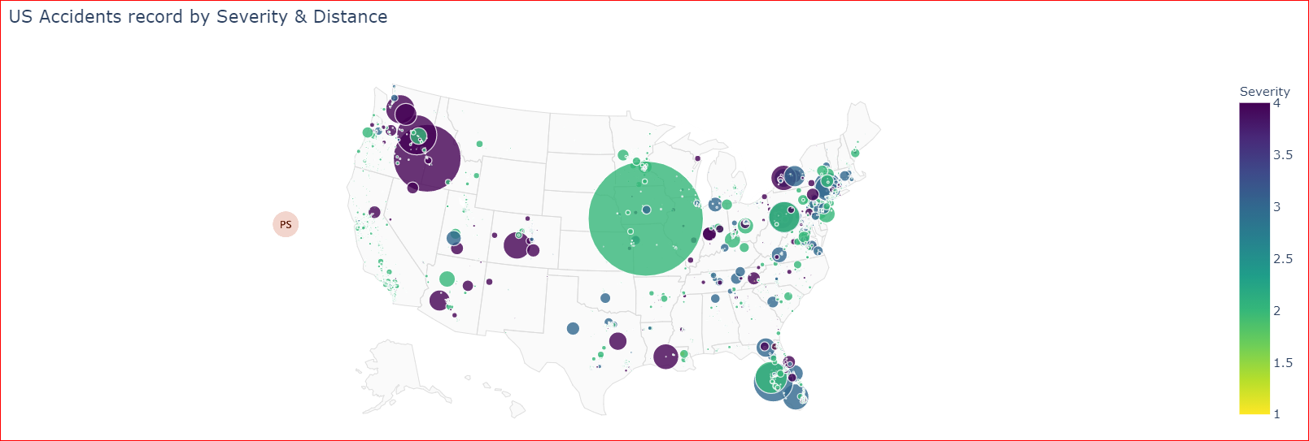
US Accident records by Distance & Severity on sample dataset (10,000)
A Countrywide Traffic Accident Dataset
DAB103-21S-003 (Analytical Tools & Decision Making 21 Spring - 003)
June,29 2021

Slide 29
References
A Countrywide Traffic Accident Dataset (2016 - 2020)
USA Accidents Data Analysis
https://www.kaggle.com/sobhanmoosavi/us-accidents/discussion/113055
how Severity the Accidents is ?
Severity Prediction in SFO Bay Area
ML to Predict Accident Severity_PA_Mont
severity and hours wasted
A Countrywide Traffic Accident Dataset
DAB103-21S-003 (Analytical Tools & Decision Making 21 Spring - 003)
June,29 2021

Slide 30
Target Audience
A Countrywide Traffic Accident Dataset (2016 - 2020)
US Citizens who are licensed to drive.
US government
A Countrywide Traffic Accident Dataset
DAB103-21S-003 (Analytical Tools & Decision Making 21 Spring - 003)
June,29 2021

Slide 31
Overall Observation Questions
1. Does the data include missing, incomplete or invalid records?
Answer : From the initial observation, looks like almost 40% of the data in the dataset is having null or missing values which will be discovered and removed in dataset cleanup part.
2. Is the data imbalanced (large number of the records represent a majority class and very few records represent the minority class)?
Answer : Yes , Many columns such as city, states, bump etc are having division in large number of the records represent a majority class and very few records represent the minority class.
3. Are some data elements highly correlated with each other?
Answer : Yes , From correlation table we observed few columns highly correlated to each other but majority of it showed weak correlation.
4. How was the data collected?
Answer : According to the Kaggle information, The dataset was collected from 2 APIs(names were not given), observing Accident events using AI Software, cameras, location information and nearby weather sensors.
5. Can you generate preliminary visualizations for individual features?
Answer : Yes, We have added Some preliminary visualization in above slides.
A Countrywide Traffic Accident Dataset
DAB103-21S-003 (Analytical Tools & Decision Making 21 Spring - 003)
June,29 2021

Slide 32



Suggestion for Future Research
Task 1 - Data Cleanup And EDA Visualizations
Task 2 - Predict the Severity of accident based on input features (If time Permits)
Task 3 – Teach Alexa to find answer from EDA graphs Plotted in the notebook (If time Permits)
A Countrywide Traffic Accident Dataset
DAB103-21S-003 (Analytical Tools & Decision Making 21 Spring - 003)
June,29 2021

Slide 33
Thank You

